Slide 1
Welcome to
Financial Readiness:
First Duty Station–Enlisted
Personal Financial Readiness

Slide 2


INTRODUCTION

Slide 3

Agenda
Module 1: Military Money
Module 2: Manage Your Money
Module 3: Smart Spending

Slide 4




Ground Rules
Breaks
Classroom logistics
Cell phones
Respect contributions of others
Sidebar conversations
EXPECTATIONS
PARKING LOT

Slide 5


What’s In Your Future?

Slide 6

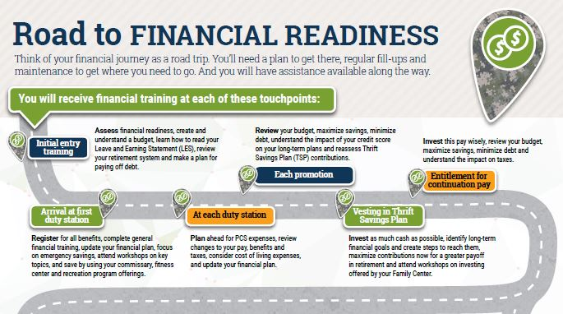
Financial Readiness Touchpoints
6

Slide 7
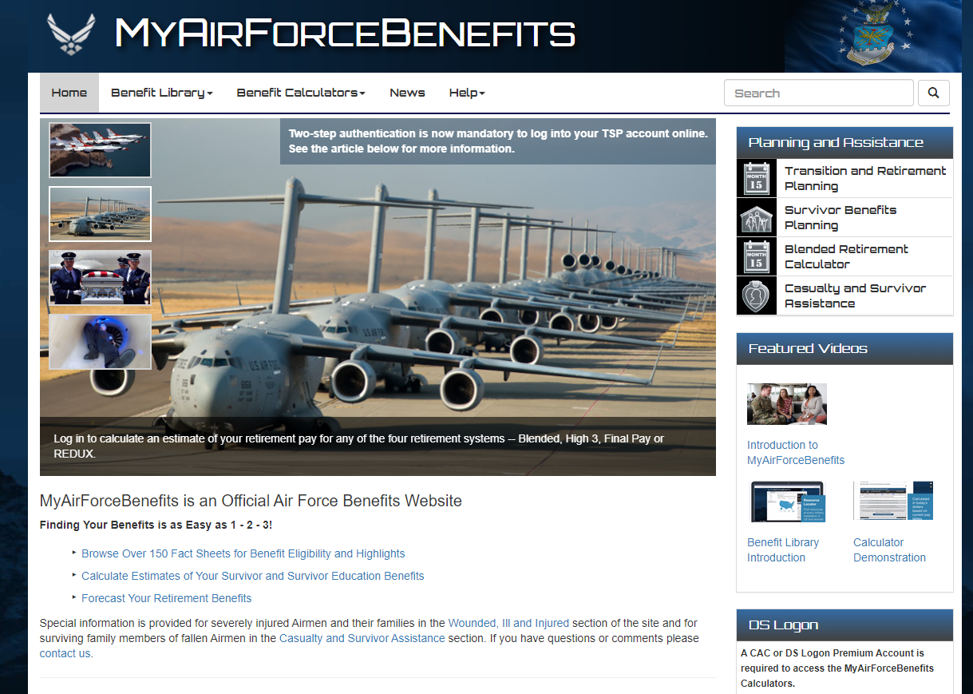
My Air Force Benefits
https://myairforcebenefits.altess.army.mil/

Slide 8
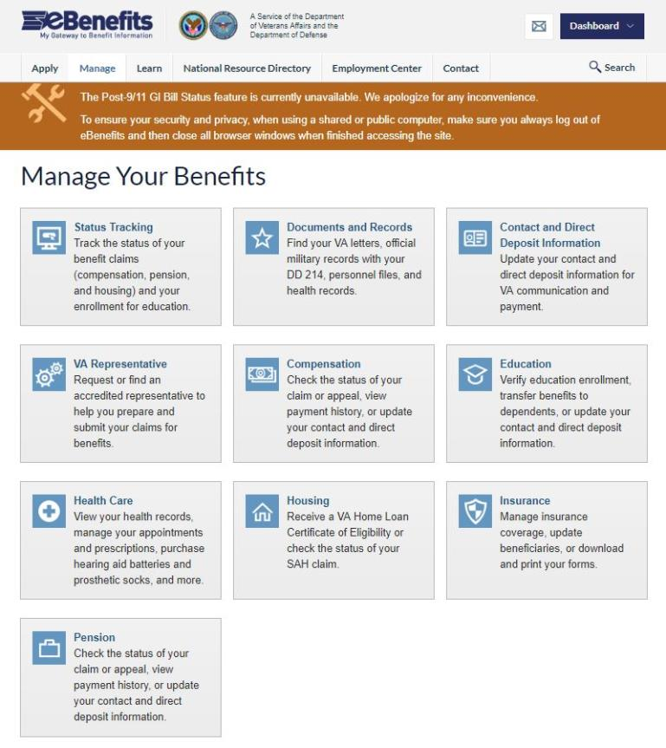
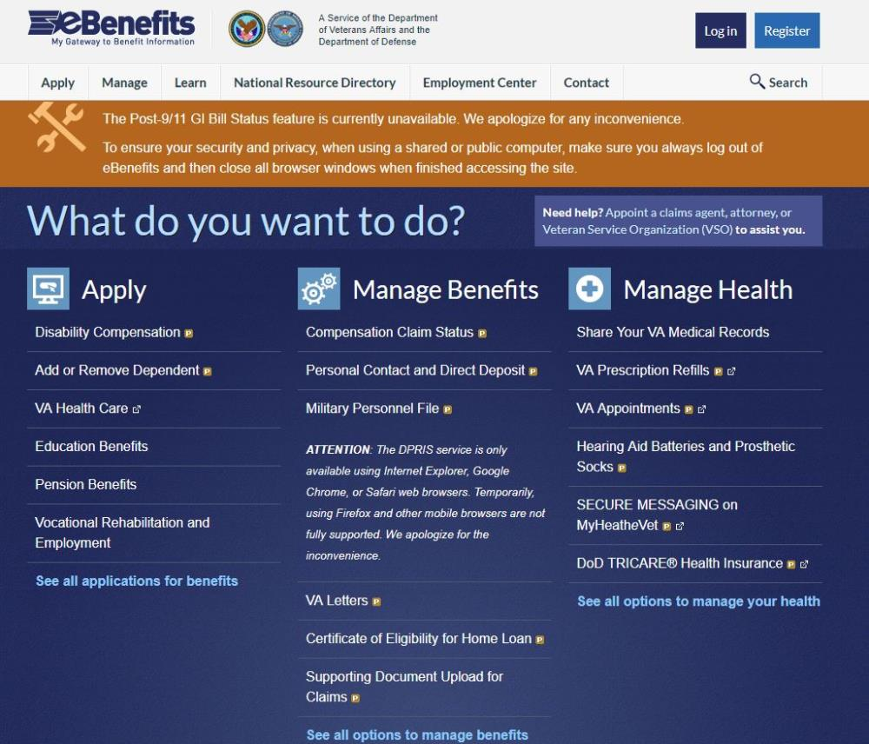
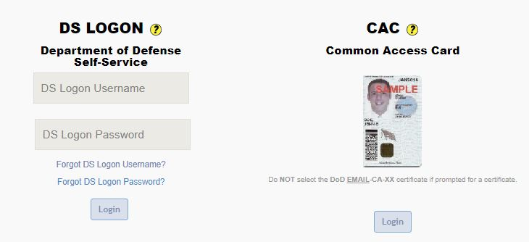
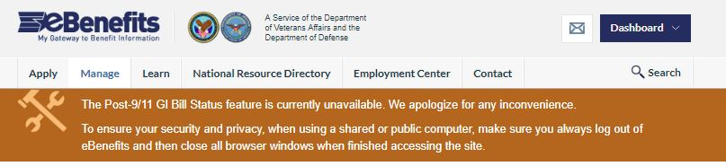
eBenefits

Slide 9

Air Force Priorities
Restore readiness…
  to win any fight, any time.
Cost-effectively modernize…
  to increase the lethality of the force.
Drive innovation…
  to secure our future.
Develop exceptional leaders…
  to lead the world’s most powerful teams.
Strengthen our alliances…
  because we are stronger together.

Slide 10
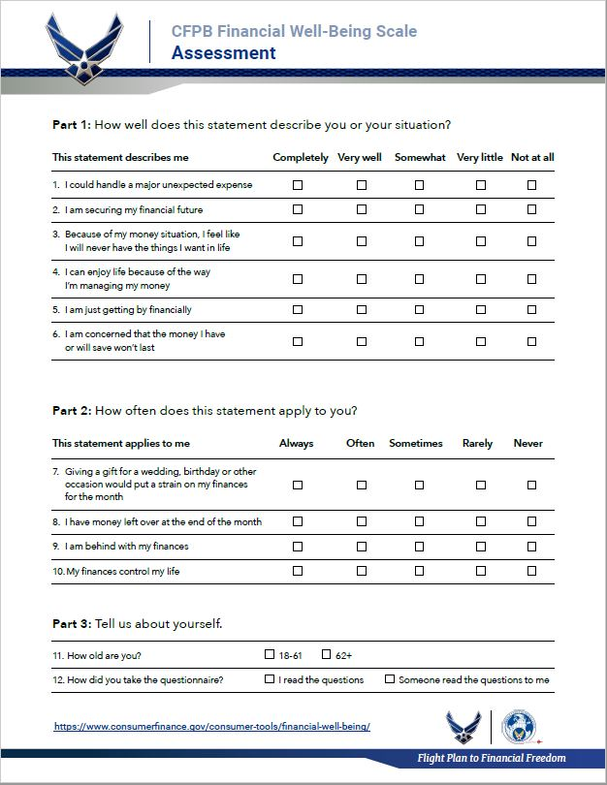
Financial Well-Being Assessment

Slide 11
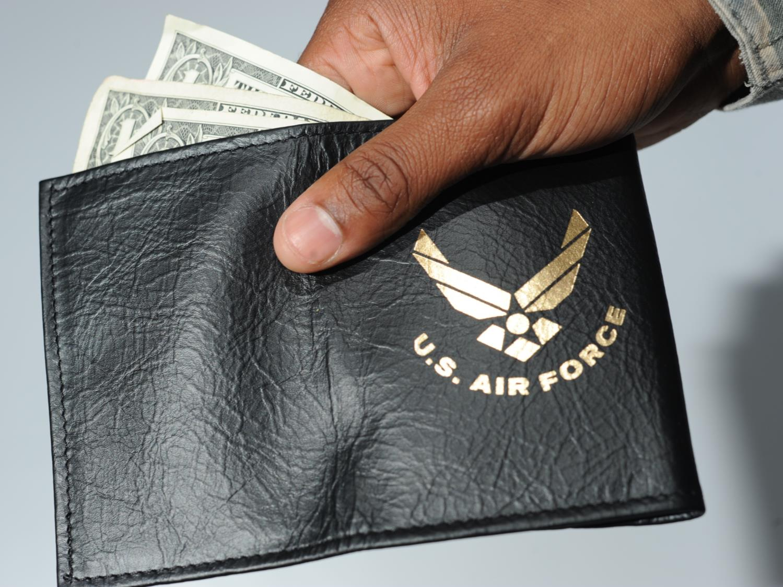
MODULE ONE:
MILITARY MONEY

Slide 12

Understanding Military Pay
Know what you are entitled to receive.
Manage changes and errors.
Manage your money.

Slide 13
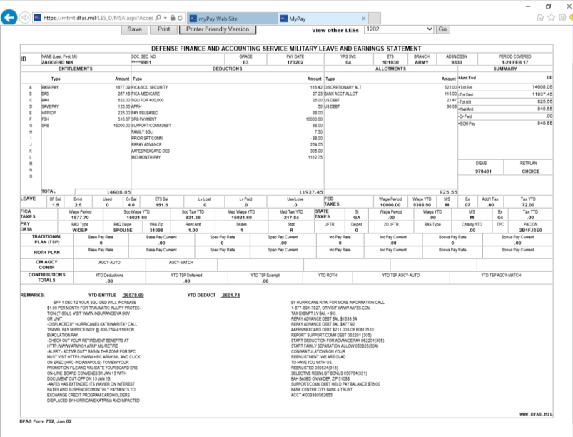

LES Beat the Bell

Slide 14


Allotments
Discretionary
Non-discretionary
Individual, institution, business
Maximum of six
Designated agency or purpose
No limit

Slide 15


Who Ya Gonna Call?

Slide 16

Finally, remember . . .
Your pay is your responsibility.
Verify that every LES is correct.
Correct discrepancies immediately.

Slide 17
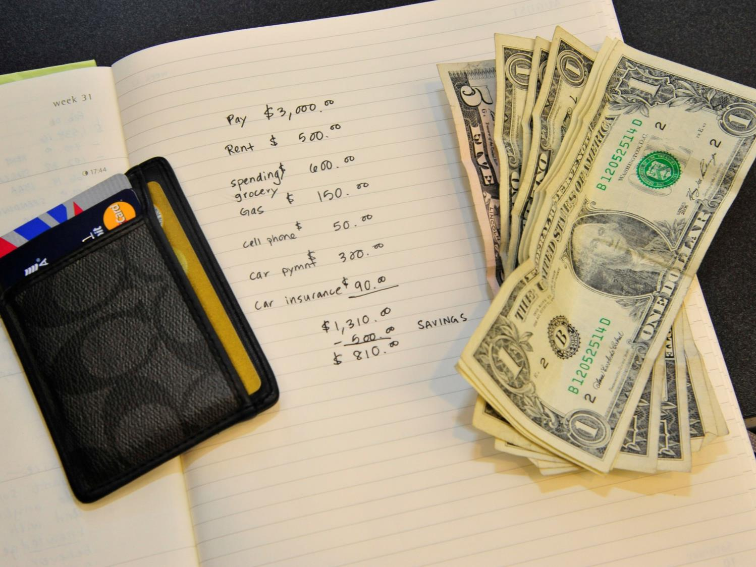
MODULE TWO
MANAGE YOUR MONEY

Slide 18
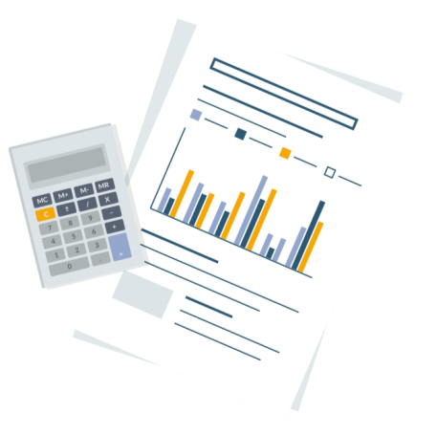
Developing Your Spending Plan
Fewer than one-third of Americans have a detailed household budget.
Using a written spending plan will help you succeed financially.

Slide 19
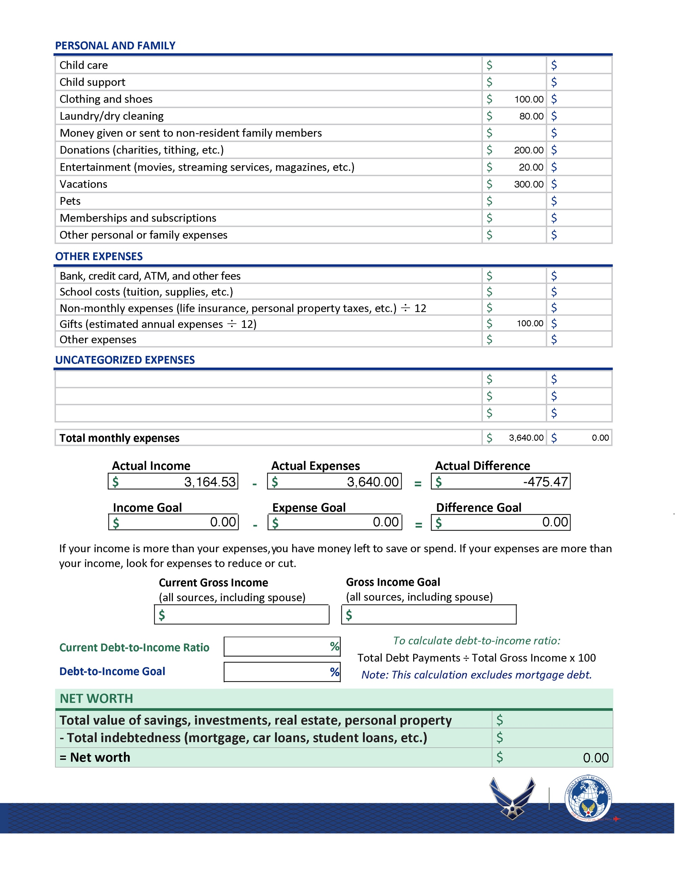
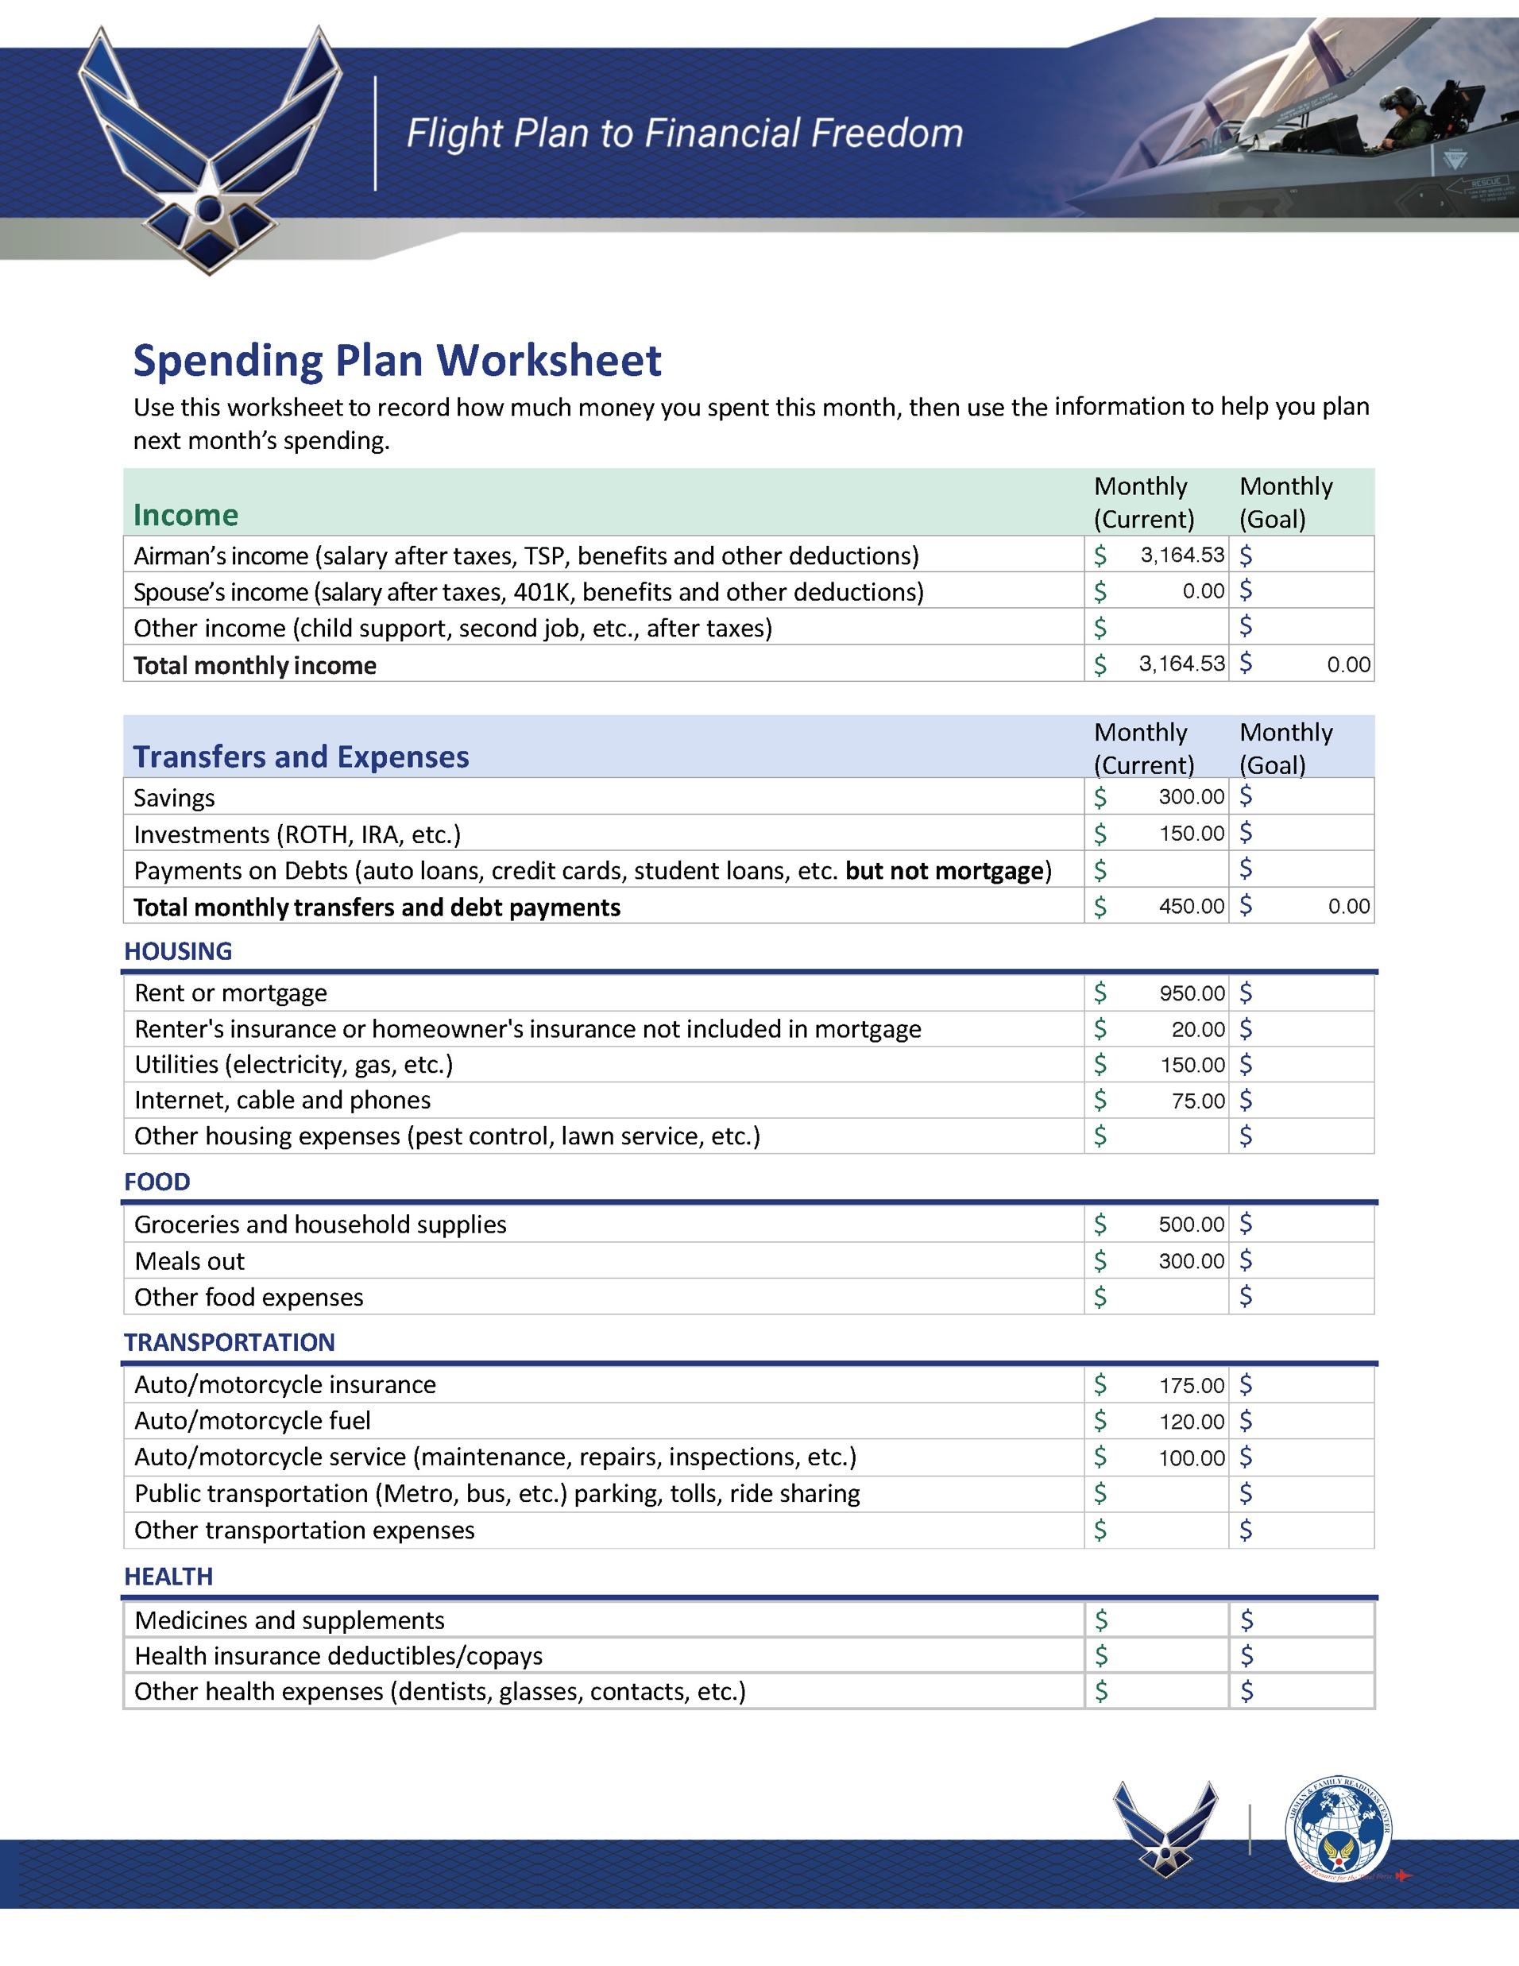
Income versus Outgo

Slide 20

Meet Michael

Slide 21

Spending Plan Worksheet

Slide 22

Savings
Reasons to save
  Emergency/reserve funds
  “Goal-getter” fund(s) (down payment for car or house, vacation fund, etc.)
Proven saving strategies: You won’t miss it if you never see it.
  Allotment(s)
  Automatic transfer(s) from
  direct-deposit account

Slide 23

Living Expenses
Housing
Food
Transportation
Health
Personal and Family
Other

Slide 24




Tracking Expenses
Be sure to track all spending!

Slide 25

The Bottom Line

Slide 26
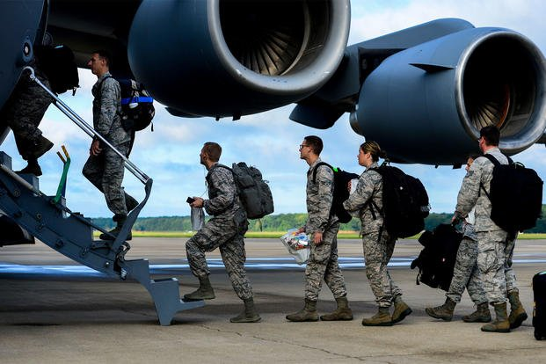
Unique Budget Challenges

Slide 27
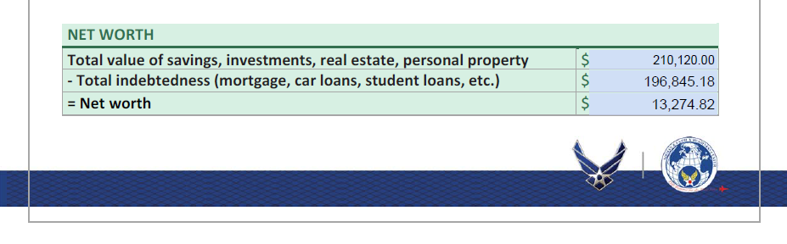
Net Worth
What you own
– What you owe
= Net worth
210,120.00
196,845.18
13,274.82
v

Slide 28
Personal Banking
Banks and credit unions
Costs of financial services
Electronic banking

Slide 29


Banks and Credit Unions
Banks
Credit Unions
  For-profit
  Non-profit

Slide 30

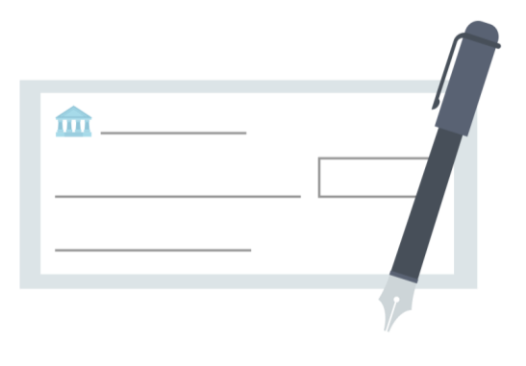
Types of Accounts
Savings Account
Checking Account

Slide 31
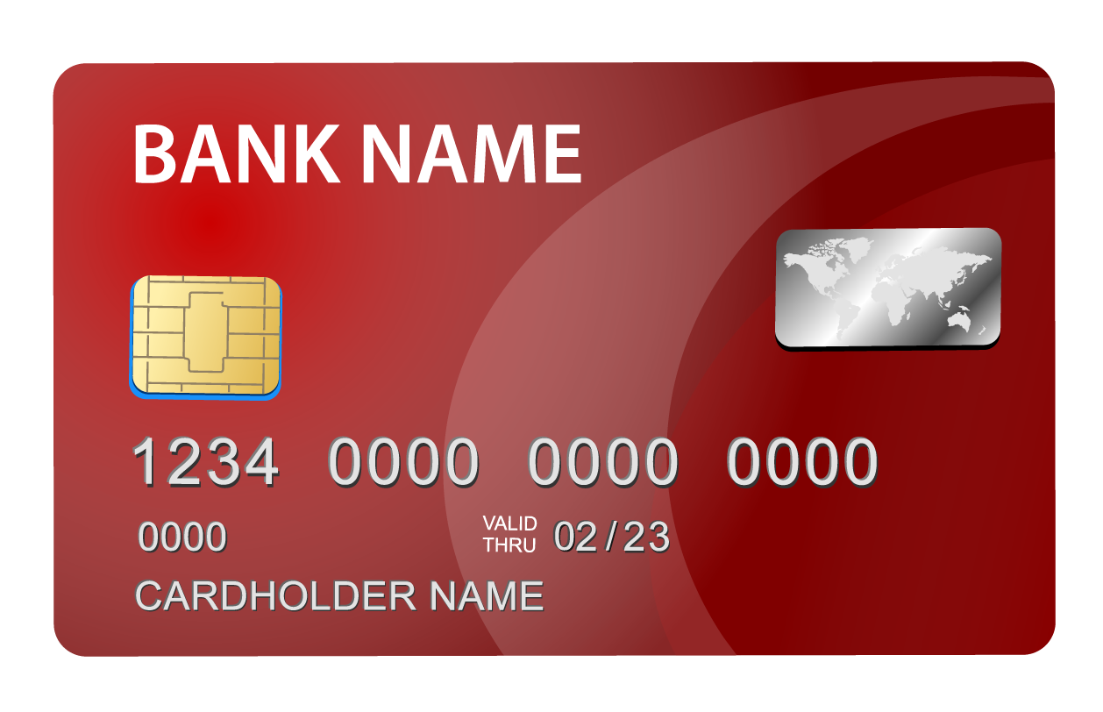
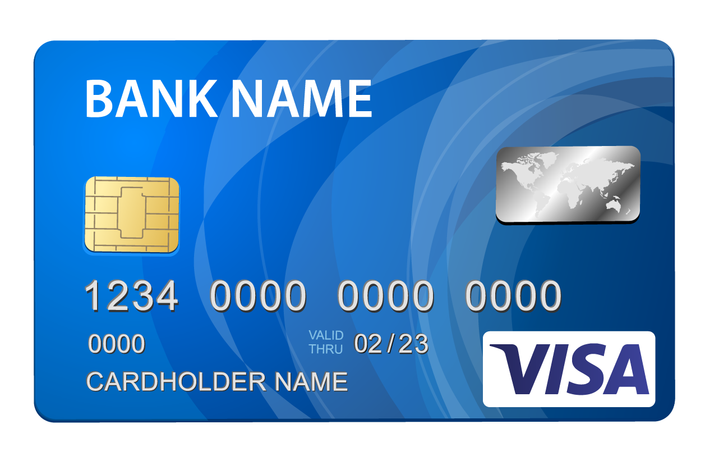
ATM, Check, and Debit Cards
ATM Cards
Check/Debit Cards

Slide 32

Safety and Protection
Sign the back of your card.
Memorize PIN and don’t share it.
Be wary when using ATMs.
Watch out for “shoulder surfers”.
Be aware of phony card readers and video surveillance.

Slide 33


Costs of Financial Services
Service/maintenance fees
Usage fees
ATM fees
Foreign transaction fees
Bill-paying fees
Check-writing fees
Overdraft charges
Stop-payment fees
Statement fees
Research fees
Account-closing fee
Check printing
Safe-deposit box rental
Other costs and fees

Slide 34

Introduction to Saving and Investing

Slide 35

The Blended Retirement System (BRS)

Slide 36

Matching Funds
1% DoD contribution
+ 5% Airman contribution
+ 4% DoD match
10% annually

Slide 37
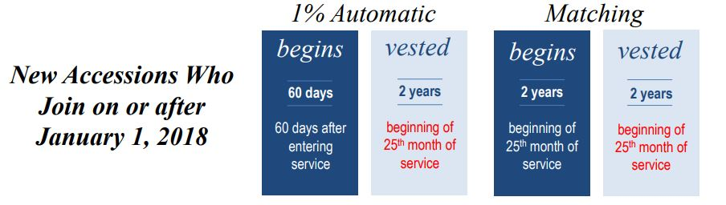
Vesting
Vesting

Slide 38
Thrift Savings Plan Funds
Contributions invested in index funds
May contribute more than DoD match
Goal: Invest at least as much as DoD will match

Slide 39

Decisions, Decisions

Slide 40

Why Investing is Important

Slide 41
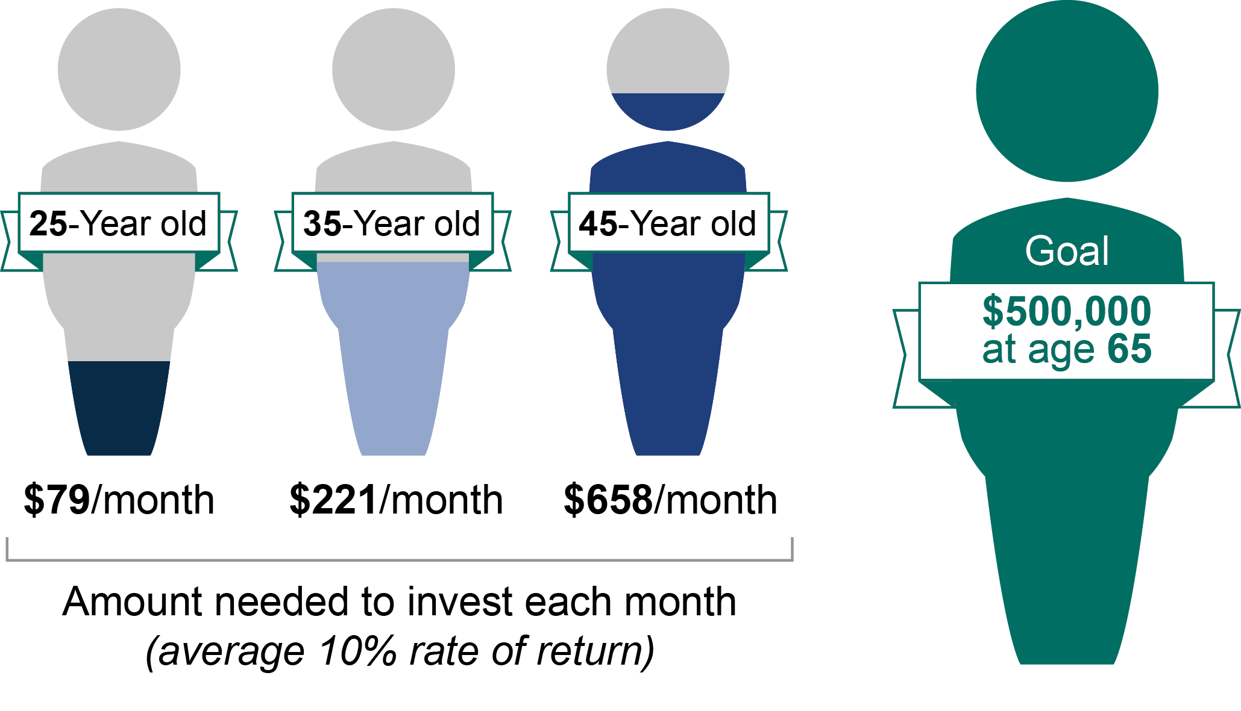
Starting Early
25-Year-old
35-Year-old
45-Year-old
$500,000
at age 67
$153/month $324/month $735/month
Amount needed to invest each month
(average 7% rate of return)

Slide 42
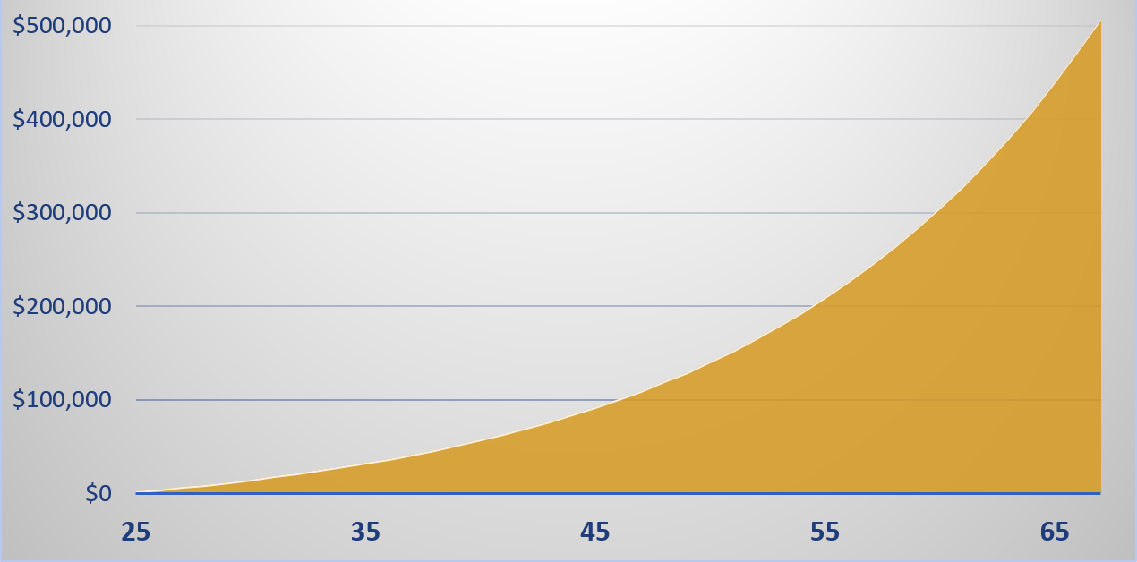
Time and Compound Earnings

Slide 43




Saving and Investing
Time Frame
Risk
Taxes and Inflation
Compounding

Slide 44


Investment Options
Personal investment accounts
Thrift Savings Plan (TSP) accounts
401(k) accounts
Individual retirement accounts (IRA)
Others

Slide 45
Techniques of Saving and Investing
Pay yourself first.
Make regular, steady investments.

Slide 46

If I Had Half a Million Dollars …
Bread
Milk
Pepper
Cereal
Invest!

Slide 47

Sources of Help
Airman and Family Readiness Center (A&FRC) PFMs and financial educators
Air Force Aid Society
Military OneSource
Online resources listed in handout

Slide 48

MODULE THREE:
SMART SPENDING

Slide 49
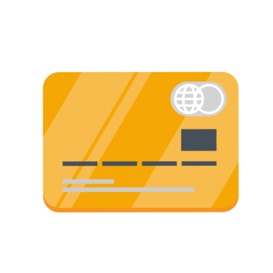
Credit and Debt Management

Slide 50

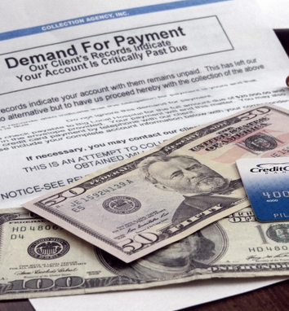
The Impact of Credit

Slide 51

What’s the Worst that Can Happen?
What are possible consequences of unwise use of credit?

Slide 52


Getting and Using Credit
Knowledge
Behavior

Slide 53
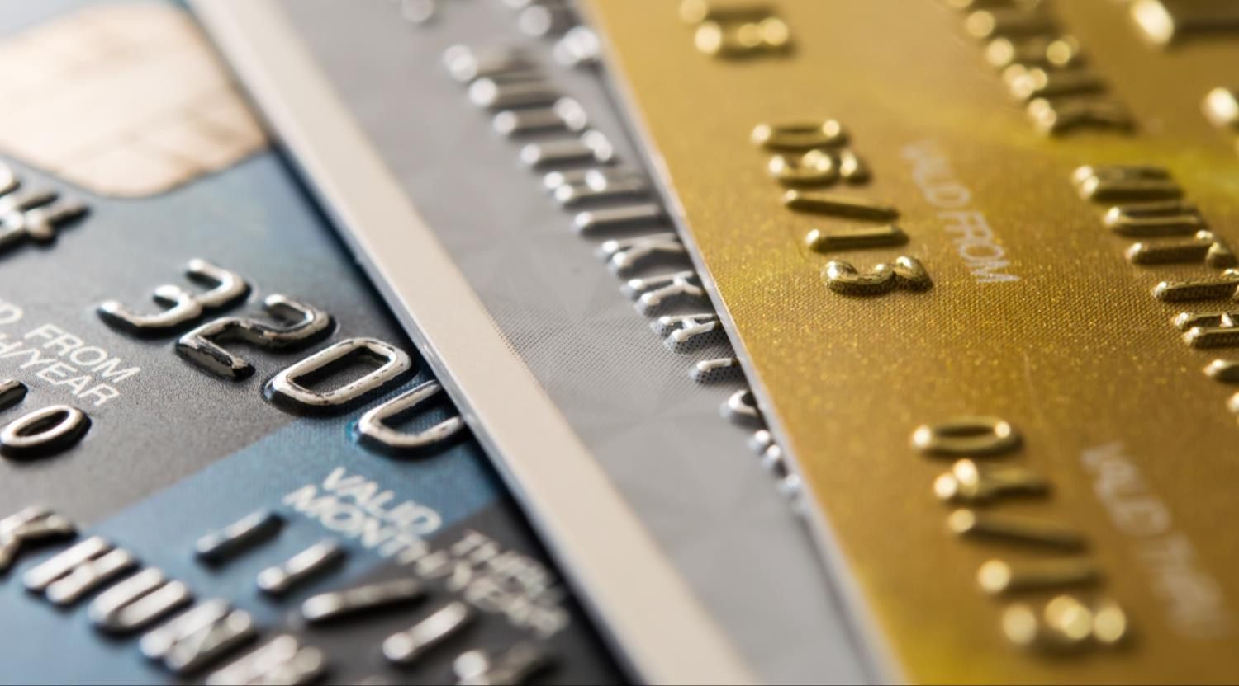
Qualifying for Credit
Character
Capacity
Collateral
53
53

Slide 54
Establishing Credit
Share-Secured Loan
Co-signed Loan
Retail Cards
Major Credit Cards

Slide 55
Wise and Unwise Uses of Credit
Wise
Planned purchases
Convenience
Unwise
Impulse buying
“Retail therapy”
Management tool
Sales or discounts
Emergencies
Status spending
Revenge spending
Everyday expenses*

Slide 56
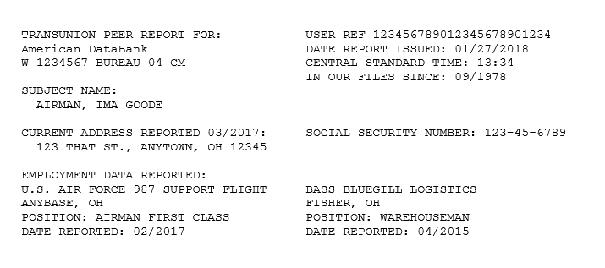
Credit Reports
Identification and employment

Slide 57
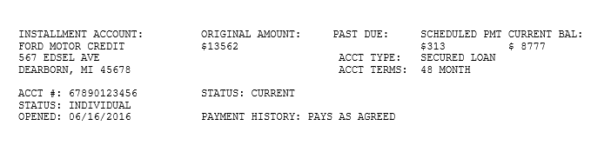
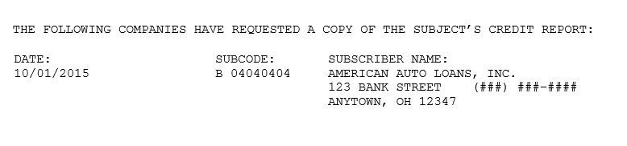
Credit Reports
Payment history
Inquiries

Slide 58
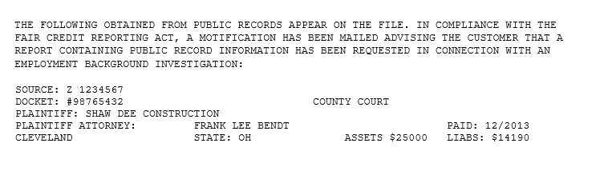
Credit Reports
Public record information
Accurate negative information
Inaccurate information

Slide 59



Credit Reports
www.annualcreditreport.com or your A&FRC

Slide 60

Credit Scores
750 and higher: Excellent
700–749: Very good
650–699: Good
600–649: Fair
599 and below: Poor

Slide 61


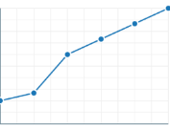

The Cost of Credit
Borrower’s credit worthiness
The lender
The amount borrowed
The repayment period

Slide 62

Government Travel Charge Cards
Airmen must apply for Government Travel Charge Card (GTCC).
Type of card issued reflects credit rating.
GTCC is for official travel ONLY.
Discipline will follow for misuse of account.

Slide 63

Managing Debt
Too much of a good thing is not a good thing.

Slide 64

Warning Signs of Credit Trouble

Slide 65
Recovering from Excessive Debt
Take charge
Prioritize debts
Power pay
Talk with creditors
Get legal counsel
Change behavior

Slide 66

Student Loan Debt

Slide 67
Sources of Help
Airman & Family Readiness Center (A&FRC) PFMs and financial educators
Base legal office
Military credit unions
Non-profit consumer counseling services
Consumer Financial Protection Bureau (CFPB) Office of Servicemember Affairs
Military OneSource

Slide 68




Financial Consumer
Awareness

Slide 69
Military Consumer Awareness
Why are service members attractive targets for consumer predators?

Slide 70



Misrepresentations, Scams, and Frauds
Misleading or incomplete information designed to confuse buyers
Designed to exploit buyers in unregulated or under-protected markets
Illegal, deliberate deception

Slide 71

Strategies for Making Major Purchases
Know what you want.
Examine buying motives.
Do not buy on impulse.
Do your homework.
Comparison shop.
Check the warranty or guarantee.
Get agreements in writing.
Sleep on it.

Slide 72

Internet Fraud
https://pdf.ic3.gov/2019_IC3Report.pdf

Slide 73



Predatory Lending
Payday loans
Auto title loans
Refund-anticipation loans

Slide 74

Identity Theft

Slide 75
Defending Against Identity Theft
Handle mail carefully
Safeguard wallet
Keep receipts
Close tampered accounts
Keep written records of contacts
Place active-duty alert during deployments

Slide 76
Legal Rights of Consumers
Canceling a Contract
Cooling-Off Period
Federal and State Laws
Cancel in writing.
Keep copies of letters.
Use certified mail.
Keep receipts.
Up to three days on certain purchases
Servicemembers Civil Relief Act (SCRA)
Military Lending Act
Lemon laws
Auto repair laws
Usury laws

Slide 77
Sources of Help
Airman & Family Readiness Center (A&FRC)
Air Force Aid Society
Armed Forces Disciplinary Control Board
Base legal office
Better Business Bureau (BBB)
Consumer Financial Protection Bureau (CFPB)
Federal Trade Commission (FTC)

Slide 78

Self-Defense
What are some things you can do to make smart purchases?
What are some examples of internet frauds?
What are some examples
of predatory lending?
How can you protect yourself from identity theft?
What are some sources of help for problems with products and services you buy?

Slide 79




Car-Buying Strategies
The Three Deals of Car-Buying
The Purchase
The Financing
The Trade-In
Legal Rights
Sources of Help
79

Slide 80




Deal # 1:
The Purchase
How much can you afford?
What kind of car do you want?
Where will you buy?
What is a fair price?
80

Slide 81
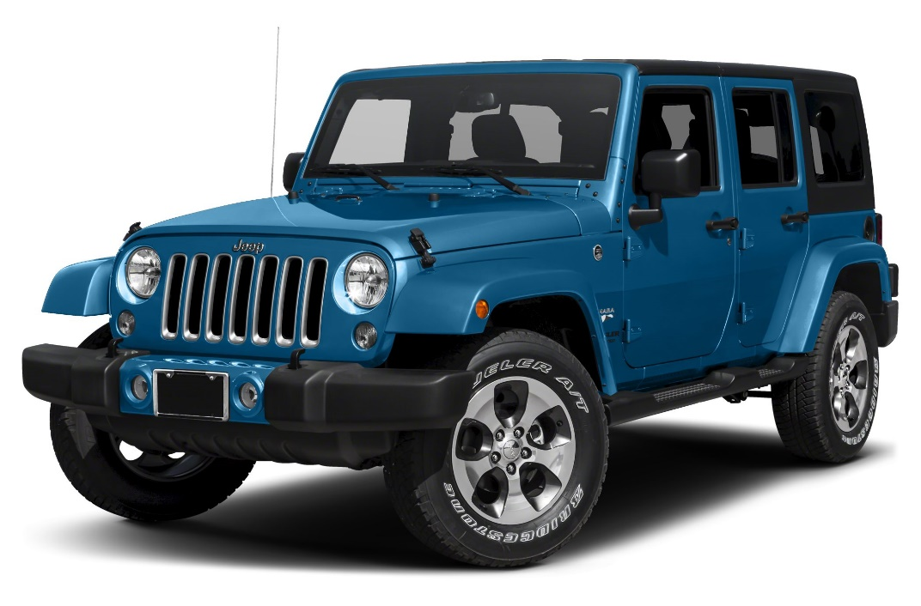
What Can You Afford?
How much can you spend in total?
How much can you put down?
How much can you spend per month?

Slide 82
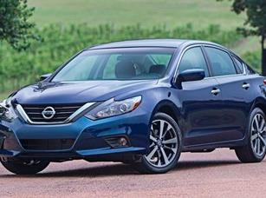
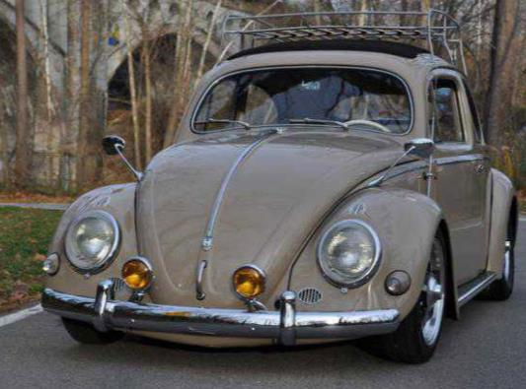
Choosing a Car
New?
Used?

Slide 83

Insurance Costs
Shop around.
Take higher deductible.
Read leases carefully.

Slide 84

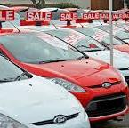
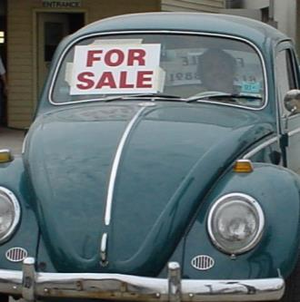


Where to Purchase Cars
Dealerships
Private Sellers
Internet
Buying Services

Slide 85

Negotiation Strategies
Be cautious with personal information.
Keep quiet about payment method.
Do not pay a deposit.
Take your time.
Walk away if you feel uncomfortable.

Slide 86

Deal # 2:
The Financing
Where will you finance?
What are the finance charges?
Where can you get help with
a contract?
86
86

Slide 87

Deal # 3:
The Trade-in
Private sale: More money,
more effort
Trade-in: Less money, more convenience
Use available resources to set
the price
87
87

Slide 88
Sources of Help
Airman and Family Readiness Center (A&FRC)
Base legal office
Library/media/online
Handouts

Slide 89

The Purpose of Insurance
Transfer risk of financial loss or hardship.
Life events affect insurance needs.
Air Force provides some insurance, but not all.

Slide 90
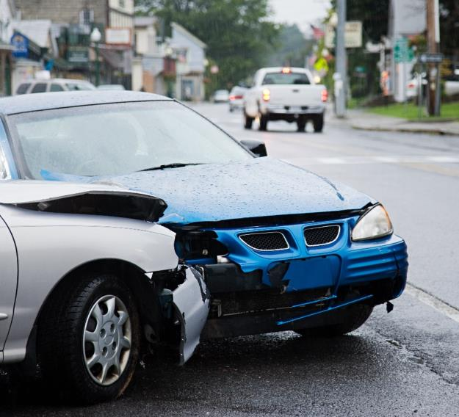
Auto Insurance
Liability
Property
Medical
Other
Optional

Slide 91

Health Insurance
Register dependents in Defense Enrollment Eligibility Reporting System (DEERS).
Coordinate any spouse benefits.

Slide 92


Life Insurance
Temporary (Term)
Insurance
Permanent Insurance
(Insurance plus savings)
SGLI
TSGLI/SGLI Disability
FSGLI
VGLI
Commercial policies
Whole life
Universal life
Variable life

Slide 93

Renters and Homeowners Insurance

Slide 94
Property Insurance Tips
Determine coverage needs and options.
Opt for replacement cost coverage.
Buy riders for valuables not covered.
Consider both liability and property coverage.
Make a property inventory and store it safely.
Be aware of exclusions.

Slide 95
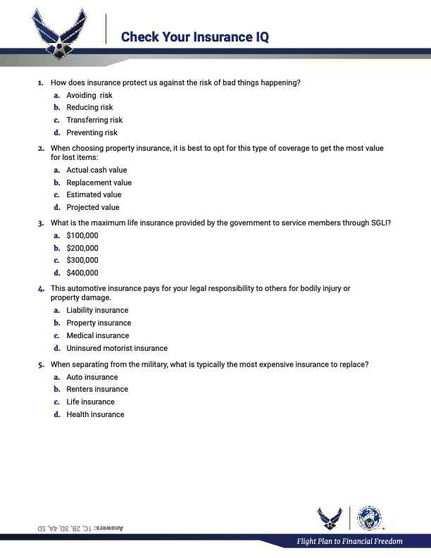
Check Your Insurance IQ

Slide 96
Check Your Insurance IQ
How does insurance protect us against the risk of bad things happening?
a. Avoiding risk
b. Reducing risk
c. Transferring risk
d. Preventing risk

Slide 97
Check Your Insurance IQ
When choosing property insurance, it is best to opt for this type of coverage to get the most value for lost items:
a. Actual cash value
b. Replacement value
c. Estimated value
d. Projected value

Slide 98
Check Your Insurance IQ
What is the maximum life insurance provided by the government to service members through SGLI?
a. $100,000
b. $200,000
c. $300,000
d. $400,000

Slide 99
Check Your Insurance IQ
This automotive insurance pays for your legal responsibility to others for bodily injury or property damage.
a. Liability insurance
b. Property insurance
c. Medical insurance
d. Uninsured motorist insurance

Slide 100
Check Your Insurance IQ
When separating from the military, what is typically
the most expensive insurance to replace?
a. Auto insurance
b. Renters insurance
c. Life insurance
d. Health insurance

Slide 101

CONCLUSION

Slide 102
Final Review
EXPECTATIONS
PARKING LOT

Slide 103

Closing
Evaluations and Certificates
Thank you!

